Slide 1



Robot POC
Robotic Process Automation
Created by Indra Rahmat

Slide 2
Agenda:
1. Overview Robot POC
2. General Workflow
3. Demo
4. Feedback (Q&A)

Slide 3
Robot POC
Job: Insert Employee Data to database System.
Precondition: there is one incoming PoC Email from User
Involved apps: Excel, PowerShell
RPA Method: processing on Ui and Background
Job: Merge PoC Data From excel to copy to Main Excel(has formula) then send to marketing
Actors:
Nalinporn as User, to Send New PoC to Email Robot
Indra as Marketing, RPA Support and Email Robot
PlatForm:
UiPath Studio
Orchestrator

Slide 4
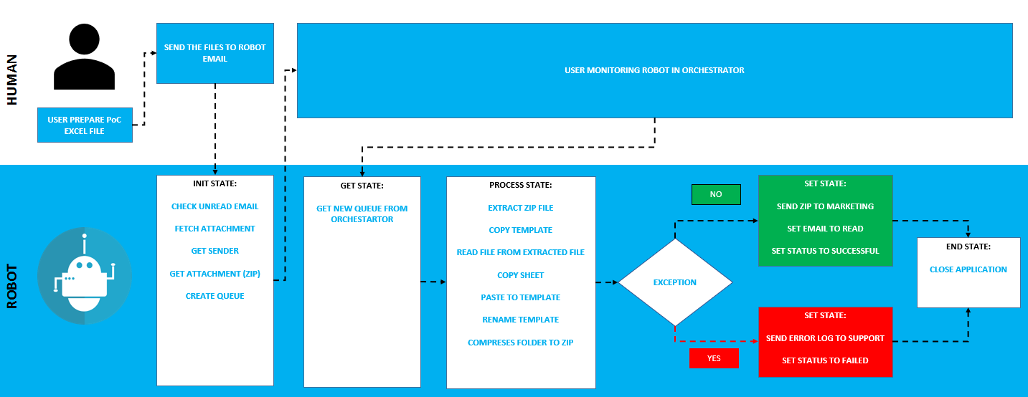
General Workflow

Slide 5

Demo Example

Slide 6
Thank You

